Slide 1
MgO

Slide 4
0.2 V

Slide 5
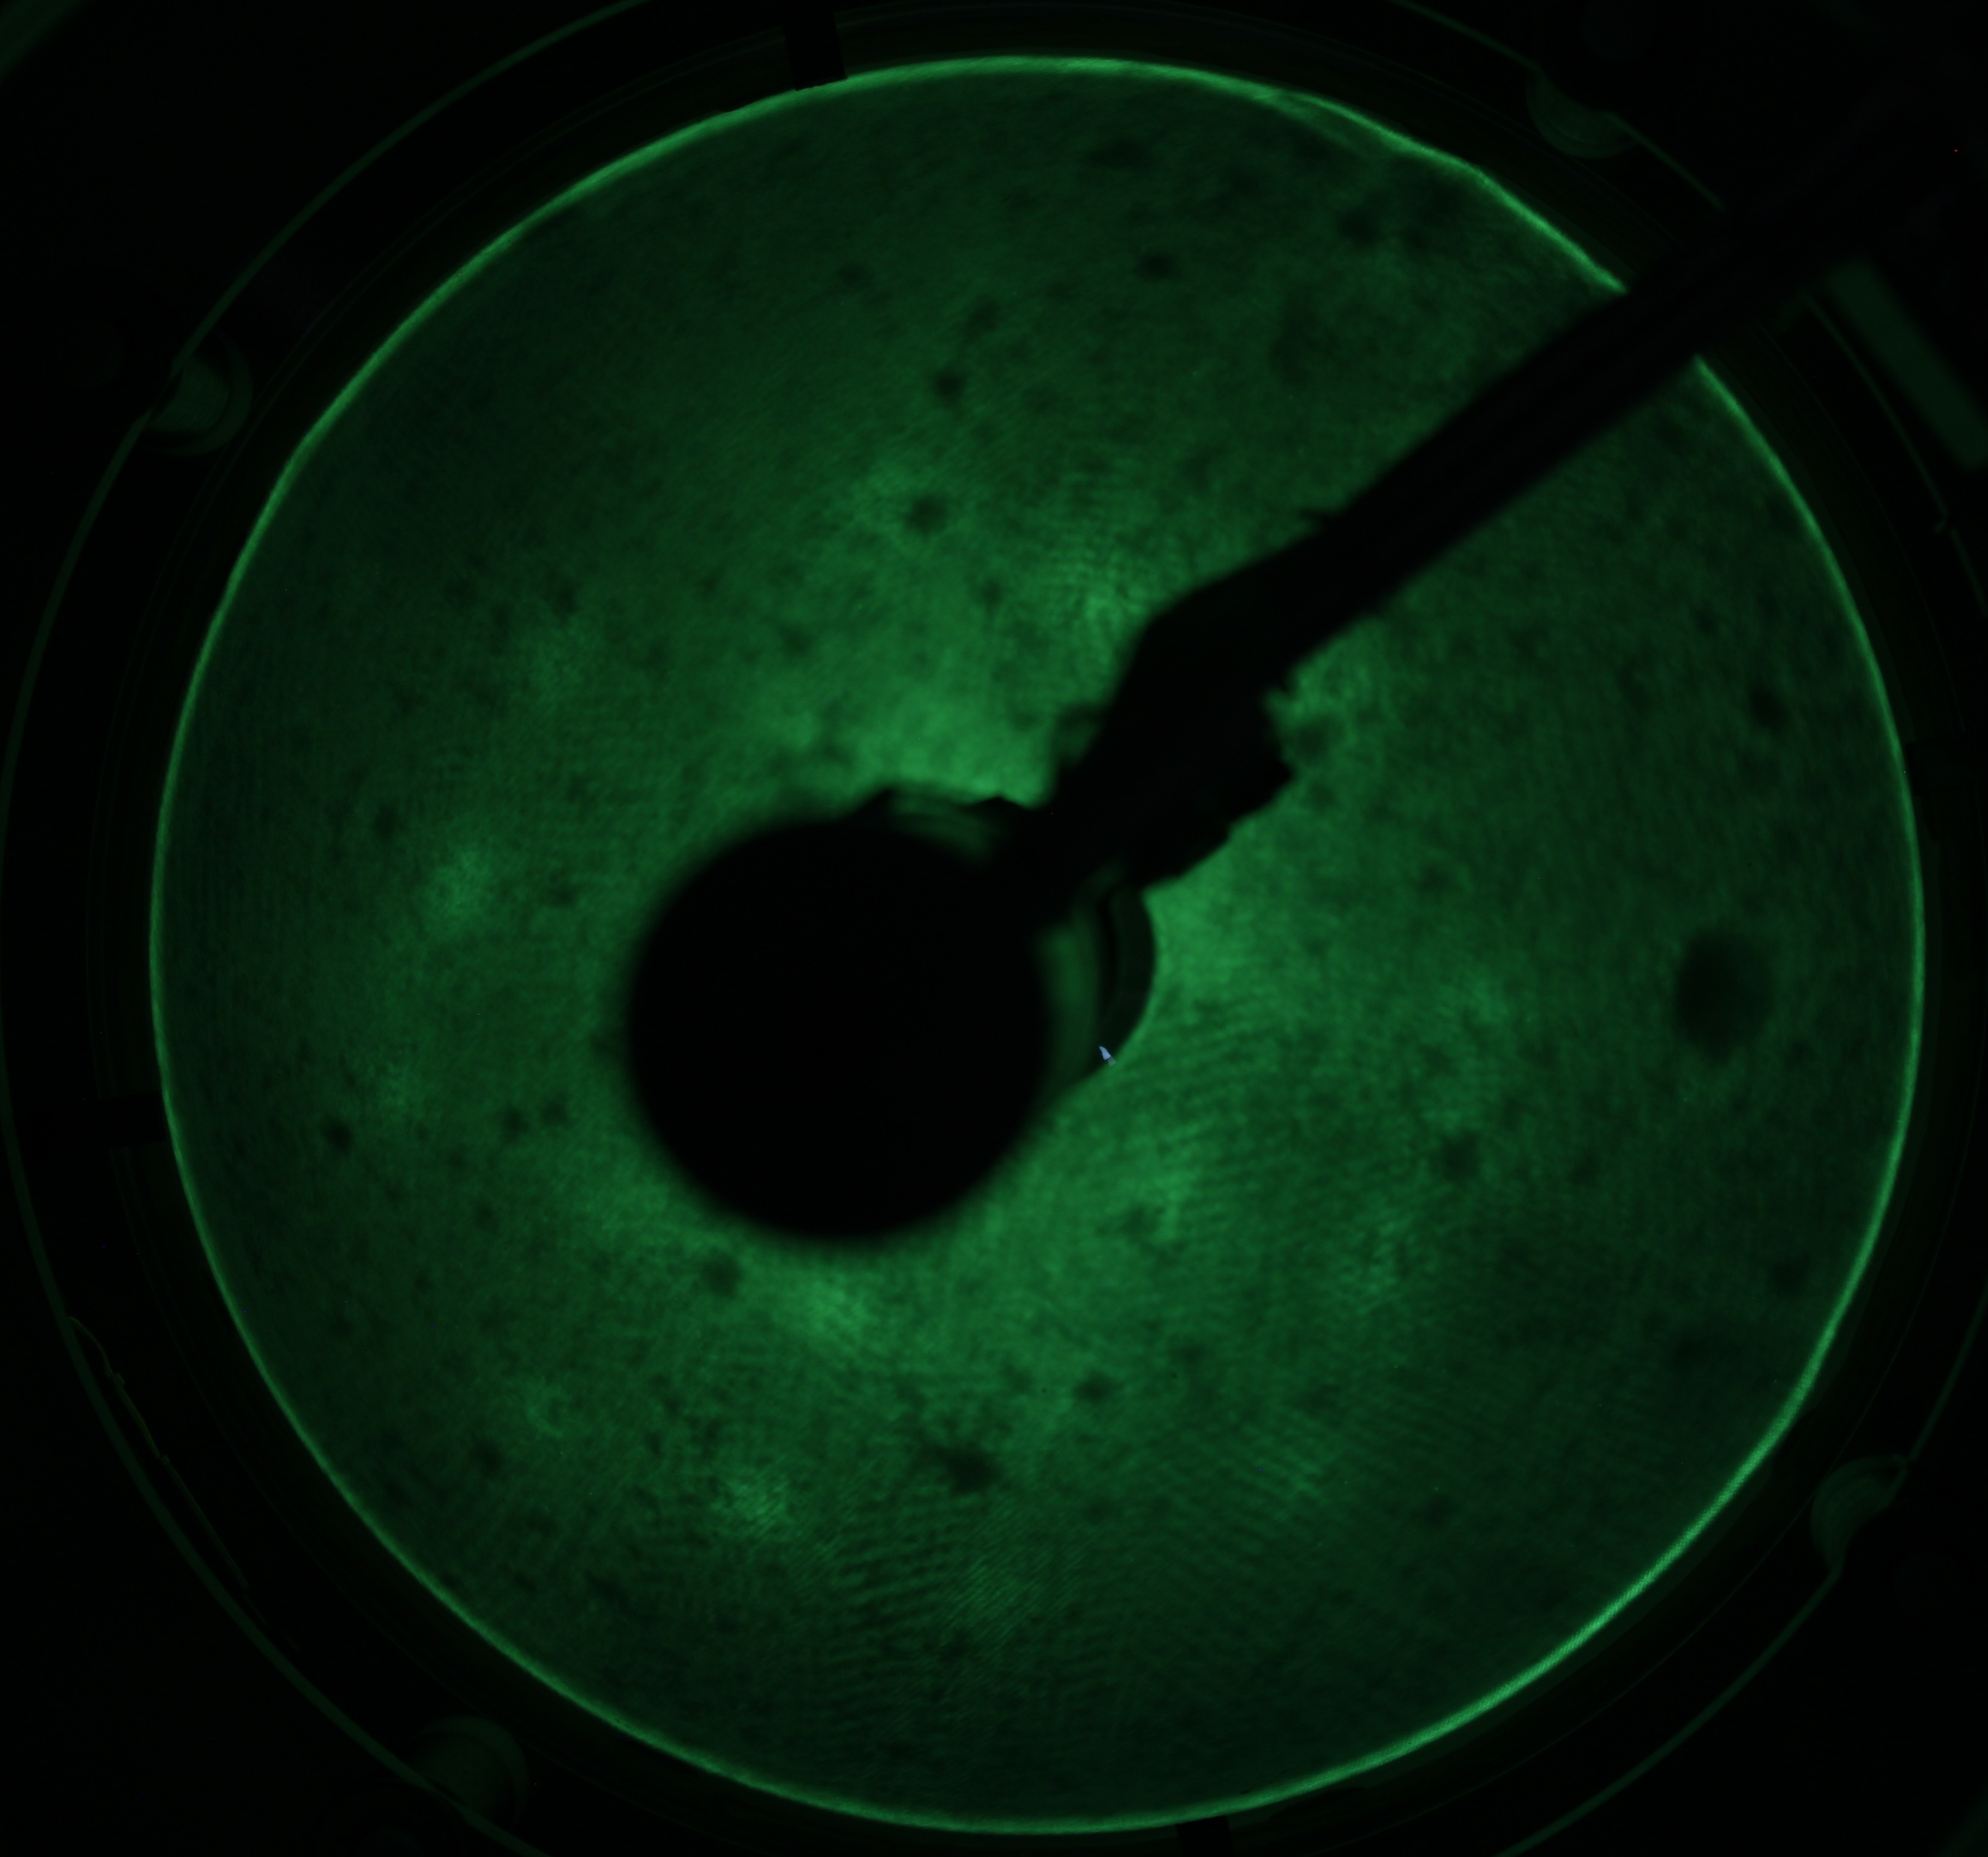
LEED picture was done at 15 eV

Slide 8
Ag

Slide 9
0.48 V
MA
[011]
[011]
Biasvolt[mV]=53.54
Current[A]=1.0E-09

Slide 10
MA
[011]
[011]

Slide 11
MA
[011]
[011]

Slide 14
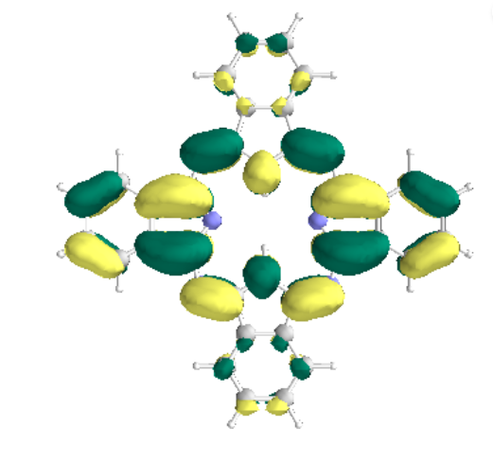
Biasvolt[mV]=749.94
Current[A]=1.9E-11
Biasvolt[mV]=-50.00, Current[A]=4.8E-11

Slide 15
Biasvolt[mV]= 50.00, Current[A]=4.8E-11

Slide 16
The STM and LEED Images of 2HPc on Ag (100) show the Formation of an ordered Structure. As seen in Images XXX the 2HPc is most likely in sqrt(17)Xsqrt(17)R14 Phase with an relative rotation of the molecular axis (MA) in respect to the [011] direction of 7 ° (see Fig XXX). Furthermore the STM Images reveal that the distance between the nearest molecules is
15 A and that the unit cell of the monolayer is also square. The Molecule itself appears as a symmetric cross with a dark center in the middle (HOMO) for positive polarity . It oriented so that the benezene ring of one 2HPc molucule is pointed towards the benzene ring of the nearest neighbor.
For negative biasvoltages (filled state imaging), near the fermi level a two fold symmetric orbital is seen. This is most likely due to charge transfer from the metal substrate , leading to an occupied LUMO and thus a charged molecule. There are two degenerated LUMOs (same Energy), with the probability density concentrated around two opposing isoindole units. The two LUMOs differ by the orientation of the the probability density around two opposing isoindole units as they are orthogonal.
The STM images (see fig xxx) reveal a connection beween two opposing isoindole units, which is in agreement with the simulated orbitals using density functional theory (DFT). There is no favored orientation seen in the STM images, it is seemingly random which suggest that the occupation probability of the two LUMOs is the same.
Ist worth mentioning that the LUMO is also visible for poitive bias which suggest two things: the negativly charged molecules LUMO is singly occupied and therefore it is possible for a electron to tunnel into that state or it tunnels into the other not occupied LUMO. The latter is suported by the

